Slide 1

Basic Level - Exercise 3 – Who are they?
Write on a white sheet of paper in a vertical row the numbers from:
from 1
2
.
.
to 7
I´m going to show you six photos now.
Your task will be, in about one minute, to write your associations related to each picture.
Photo № 1 corresponds to № 1 in your sheet.
Next to the corresponding number, write down the first impression you get when looking at the picture!

Slide 2
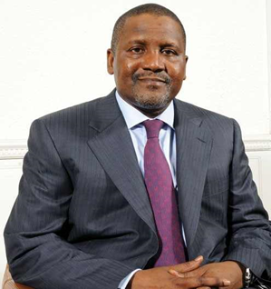
Photo № 1
Source:https://www.google.com/url?sa=i&rct=j&q=&esrc=s&source=images&cd=&ved=2ahUKEwiLw5mew_jlAhUCaFAKHax7D4MQjRx6BAgBEAQ&url=https%3A%2F%2Fkadinvest.org%2Fopalsingleevent-speaker%2Faliko-dangote%2F&psig=AOvVaw3PYLWVd4s7F6TEw9HQQ2hl&ust=1574330140091973

Slide 3
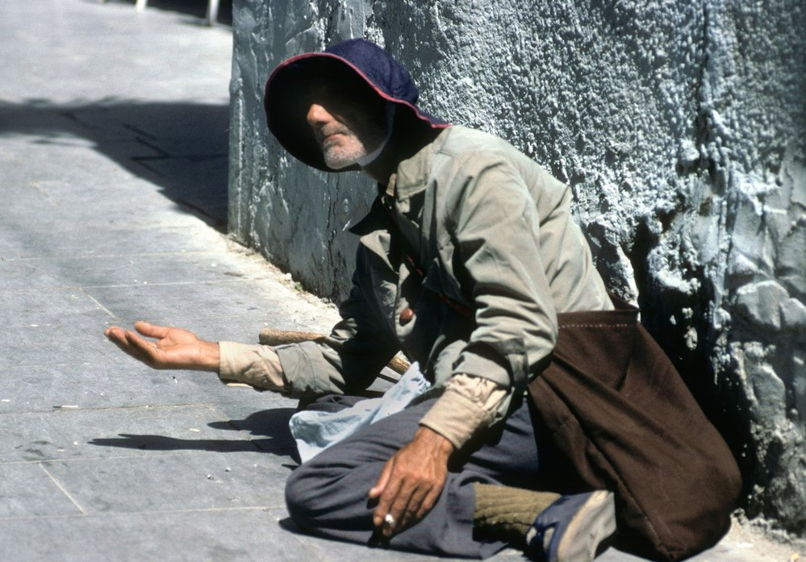
Photo № 2
Source: https://www.reflex.cz/clanek/zpravy/80885/dansko-posila-lidi-do-vezeni-za-zebrani-na-ulicich-staci-si-rict-o-drobaky-proc-to-nejde-u-nas.html?fb_comment_id=1418006664954988_1423494637739524

Slide 4
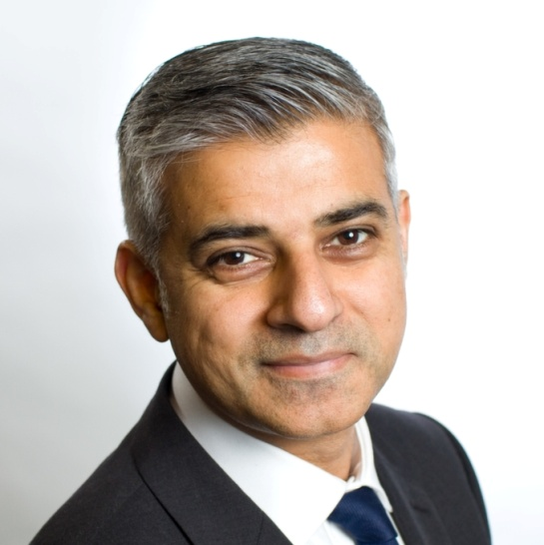
Photo №3
Source: https://www.transport-network.co.uk/Sadiq-Khan-considers-single-unified-road-charging-scheme-for-London/14197

Slide 5
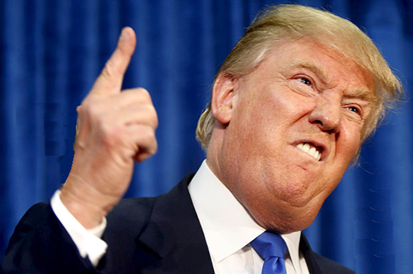
Photo №4
Source:https://www.google.com/url?sa=i&rct=j&q=&esrc=s&source=images&cd=&ved=2ahUKEwjSrvqzxfjlAhXEYlAKHZD_CMIQjB16BAgBEAM&url=https%3A%2F%2Fwww.reflex.cz%2Fclanek%2Fcausy%2F73261%2Fzdrave-agresivni-donald-trump-jak-se-nemilosrdny-manazer-stal-prezidentem-usa.html&psig=AOvVaw0xpL5miwT2K1430gR2kIvc&ust=1574330797653424

Slide 6
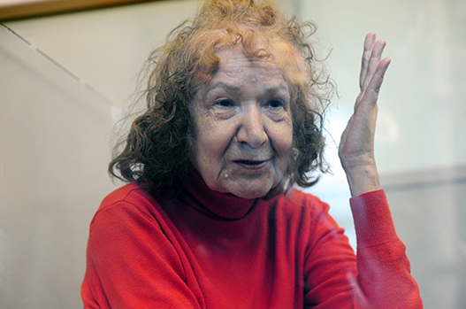
Photo №5
Source: https://universaljournalreview.wordpress.com/2015/08/05/tamara-samsonova-68-year-old-suspected-russian-serial-killer-dubbed-granny-ripper-now-suspected-of-eating-victims/

Slide 7
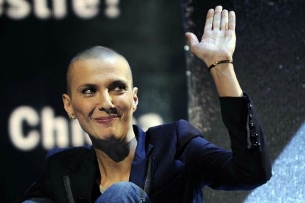
Photo №6
Source: https://www.giornalettismo.com/la-nuova-vita-lesbo-di-rosalinda-celentano/

Slide 8
Questions for discussion:
What associations or reactions were evoked by these pictures?
What has impressed you most in these images?
Are there any similarities or differences in these pictures?
Are there any prejudices (stereotypes) among the things you have written and which ones? Can you share them?
Did any prejudices (stereotypes) affect your judgement?

Slide 9
The identity of the people in the pictures
Aliko Dangote (Nigerian, the richest black man in the world)
Beggar
Sadiq Khan (Mayor of London, a Pakistani by origin, the first Muslim mayor of a European capital)
Donald Trump (US President of the Republican Party; nominated for the Nobel Peace Prize in 2016 by an anonymous sender for "his vigorous struggle for peace by strengthening the ideology used as a weapon to deter radical Islam, the “Islamic State”, and “Communist China“)
Tamara Samsonova (Russian, a serial killer)
Adriano Celentano's daughter (Rosalinda is a lesbian)

Slide 10
This project has been funded with support from the European Commission. This publication [communication] reflects the views only of the author, and the Commission cannot be held responsible for any use which may be made of the information contained therein.

